Slide 1
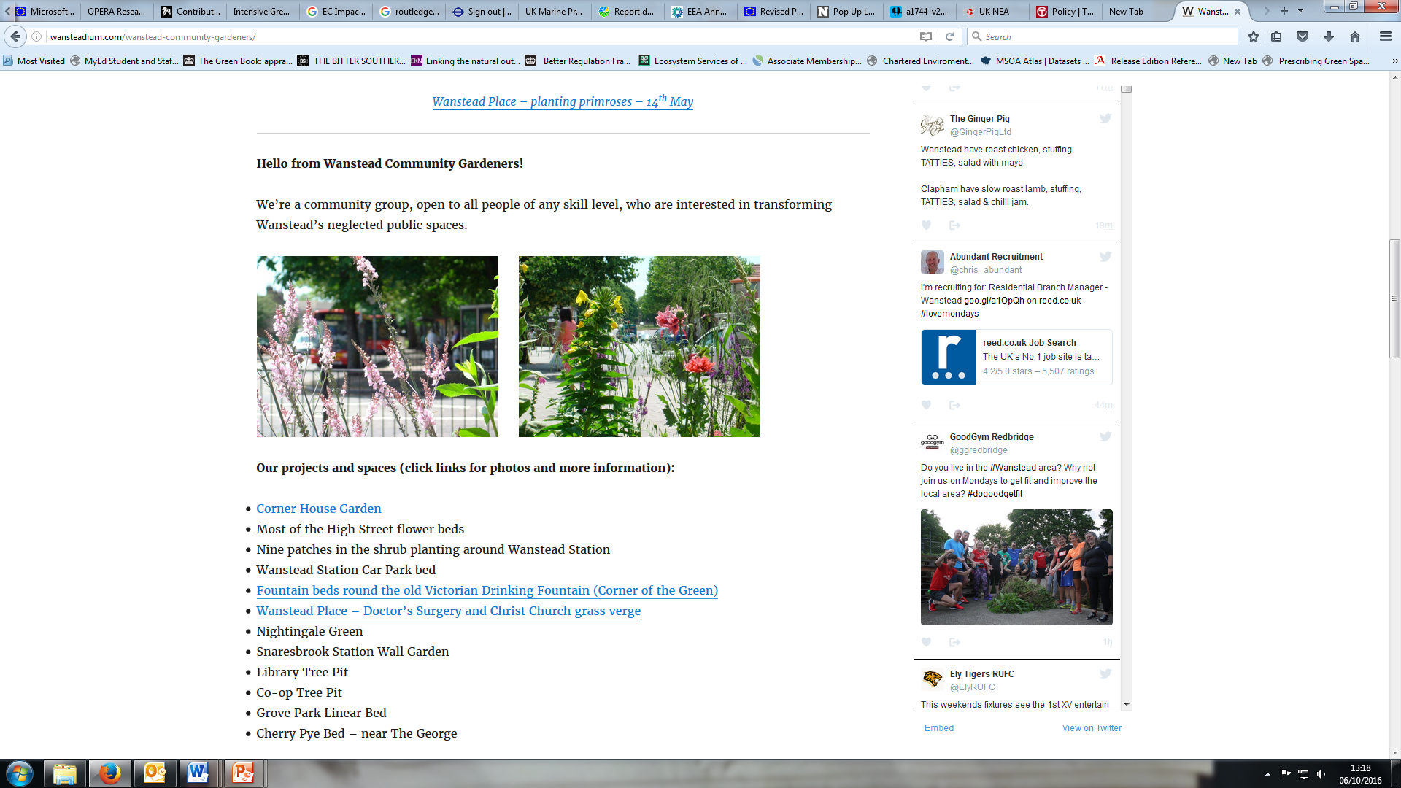
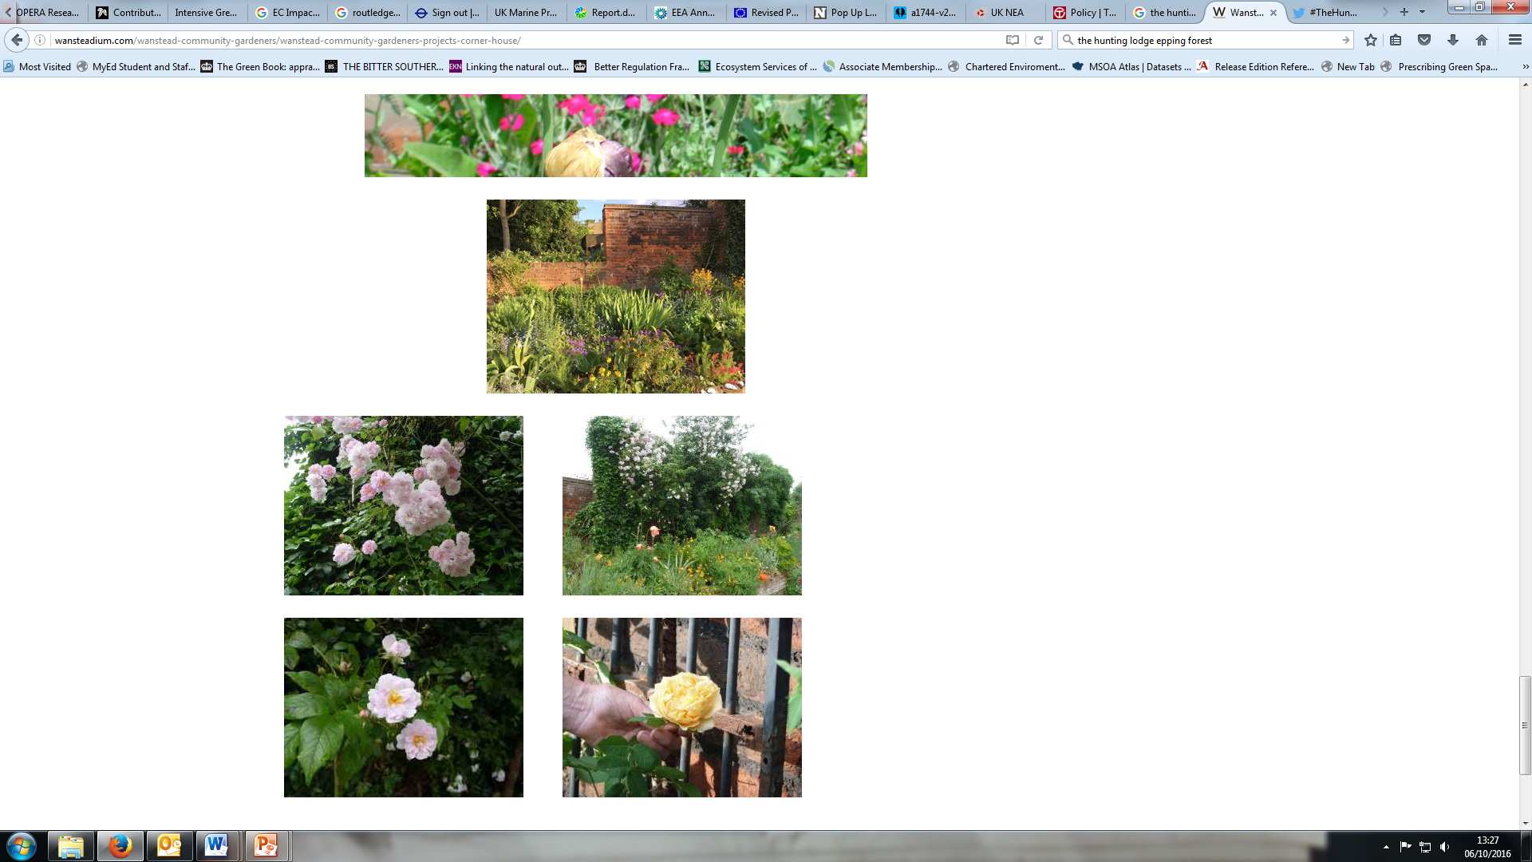
Don’t Mow Let it grow - Economic Appraisal
Erin Gianferrara
DMLIG SG meeting
Thursday 13th October 2016
Wanstead Community Gardeners.

Slide 2
Economic appraisal of grassland mgmt options
  What?
  The aim of the appraisal is a cost benefit analysis of the change in different management options
      This will include the wider social, environmental and economic benefits
  It will provide results which can be presented to stakeholders and decision makers
  The completed economic appraisal and process will be provided for inclusion in the project’s Toolkit
Notes:
We will be conducting the economic appraisal of the different grassland management options
The aim of the appraisal is a cost benefit analysis of the change in different management options
This will include the wider social, environmental and economic benefits
Results will be presented to wider stakeholders and decision makers
The EA and process will be included in the project’s Toolkit

Slide 3
Data needs
  Data needs
  The baseline/current situation for all sites:
    Info on the presence of, and type of, priority/key/indicator species on the site
    Size (area) – already available
    Cost of current management activities
  For amenity sites (also relevant for larger, accessible road-side verges):
    Same info as above, and
    Current number of visitors
  For management options:
    Biodiversity impacts
    Costs of management options
Notes:
What we have done so far is identify some data needs that will enable and/or enhance the CBA
These next couple of slides set out the data needs, which have been circulated via email in the previous weeks.

